Slide 4
Types

Slide 8
Tropical Grassland

Slide 9
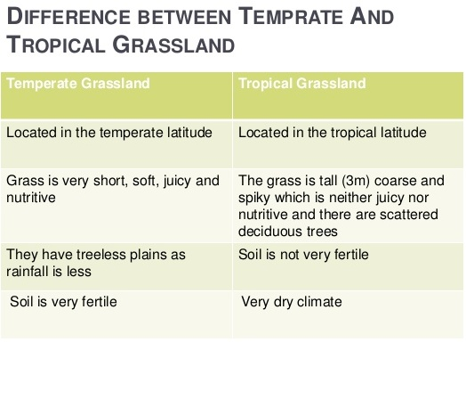

Slide 14
